Slide 1
Understanding
Career Aspirations
of Gen-Z
Presented by Pavithra

Slide 2


PROCESS
1
Data Understanding
2
Data Collection
3
Data Cleaning
4
Data analysis
5
Conclusion

Slide 3
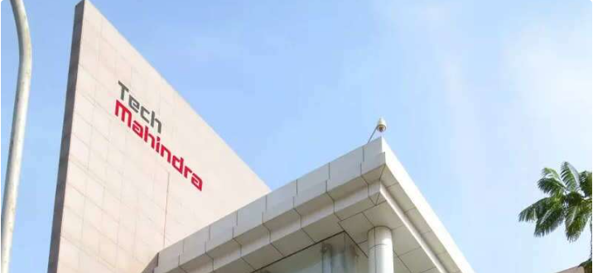
Tech mahindra is an indian multinational information technology services and consulting company.
Revenue: 53,255.2 crores INR (US$6.7 billion, 2023)
Number of employees: 148,297 (June 2023)
Tech Mahindra is rated 3.7 out of 5, based on 25.8k reviews by employees on AmbitionBox.
Employees rated high for Job Security which is 3.6 and promotions / appraisal which is rated least at the 3.1

Slide 4
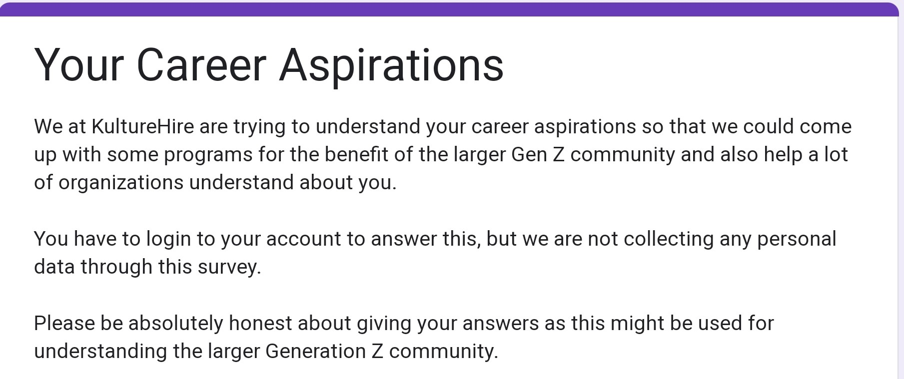
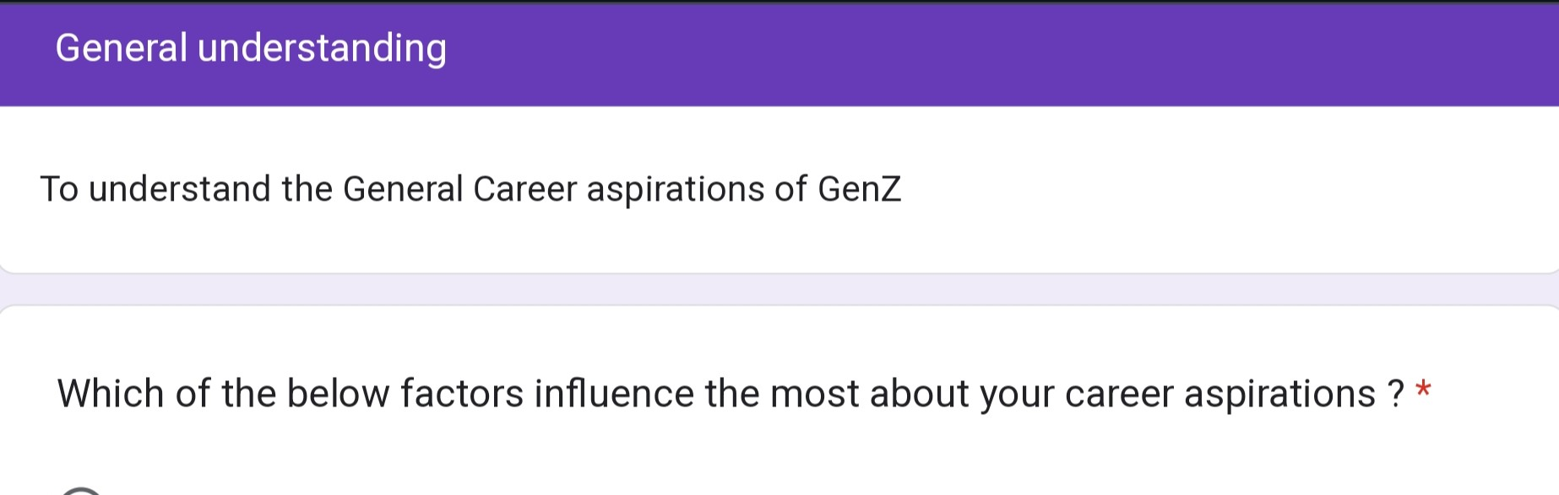


DATA COLLECTION

Slide 5
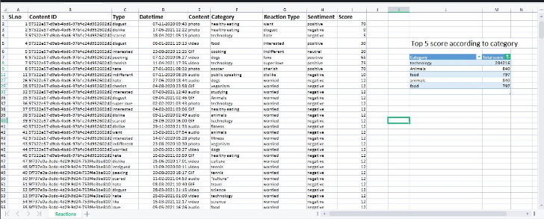
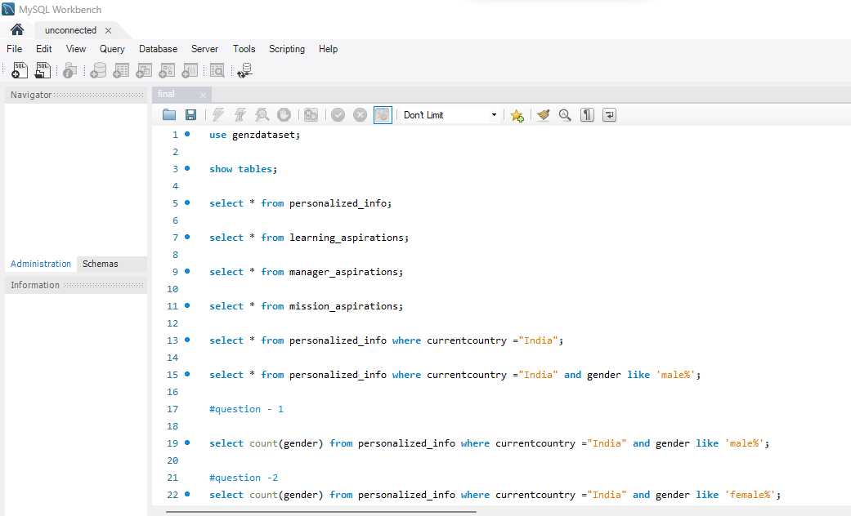
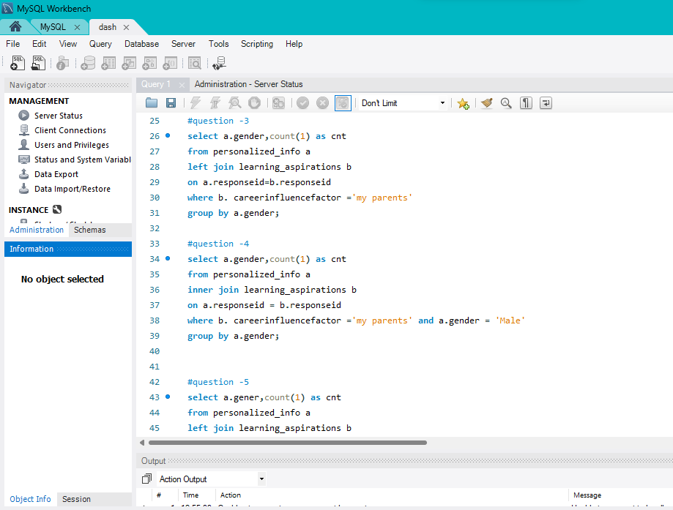
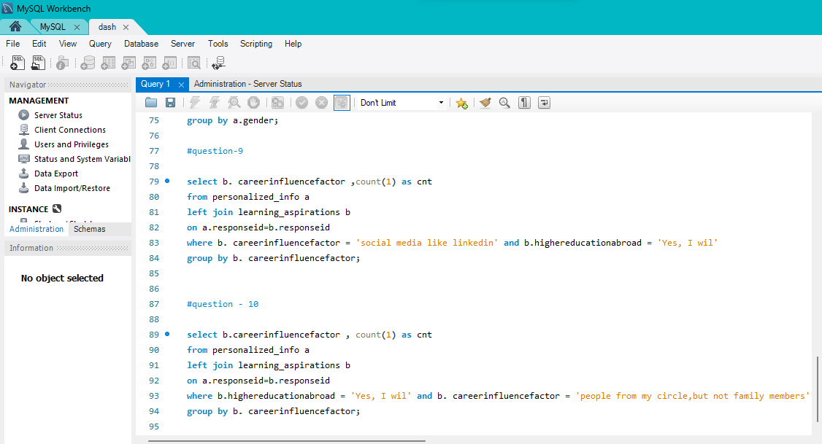
DATA CLEANING

Slide 6
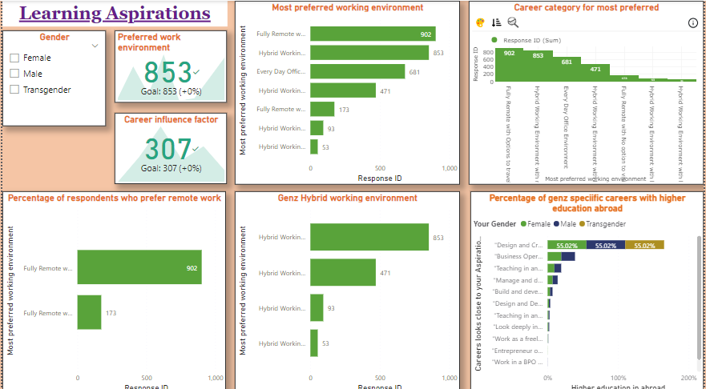
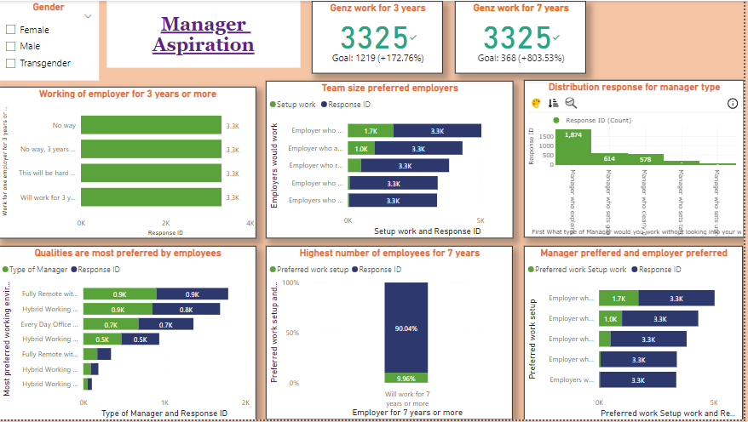
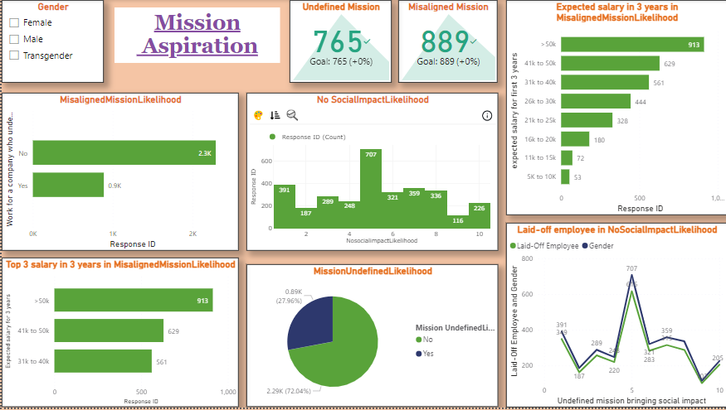
DATA ANALYSIS

Slide 7
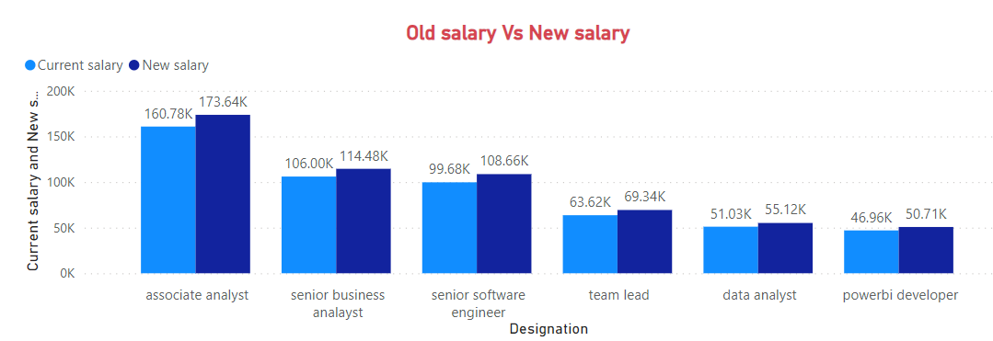
WILL GENZ work?
Problem:
Lack of salary growth
Issues with appraisals and promotions

Slide 8
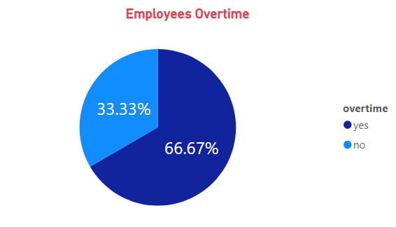
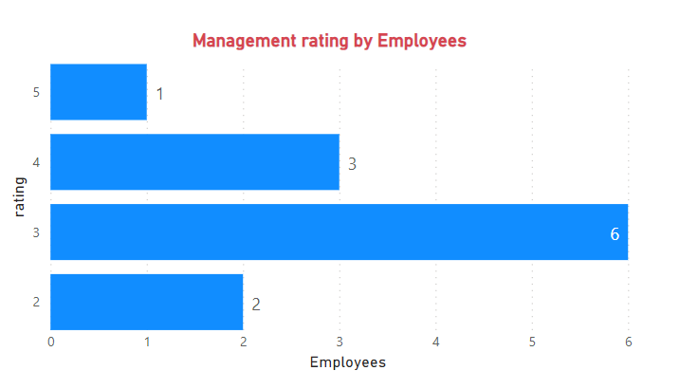
Problem:
Lack of support from management and tech - team
Unnecessary pressure by cutting holidays
Forced to do overtime

Slide 9
Thank you

